Slide 1
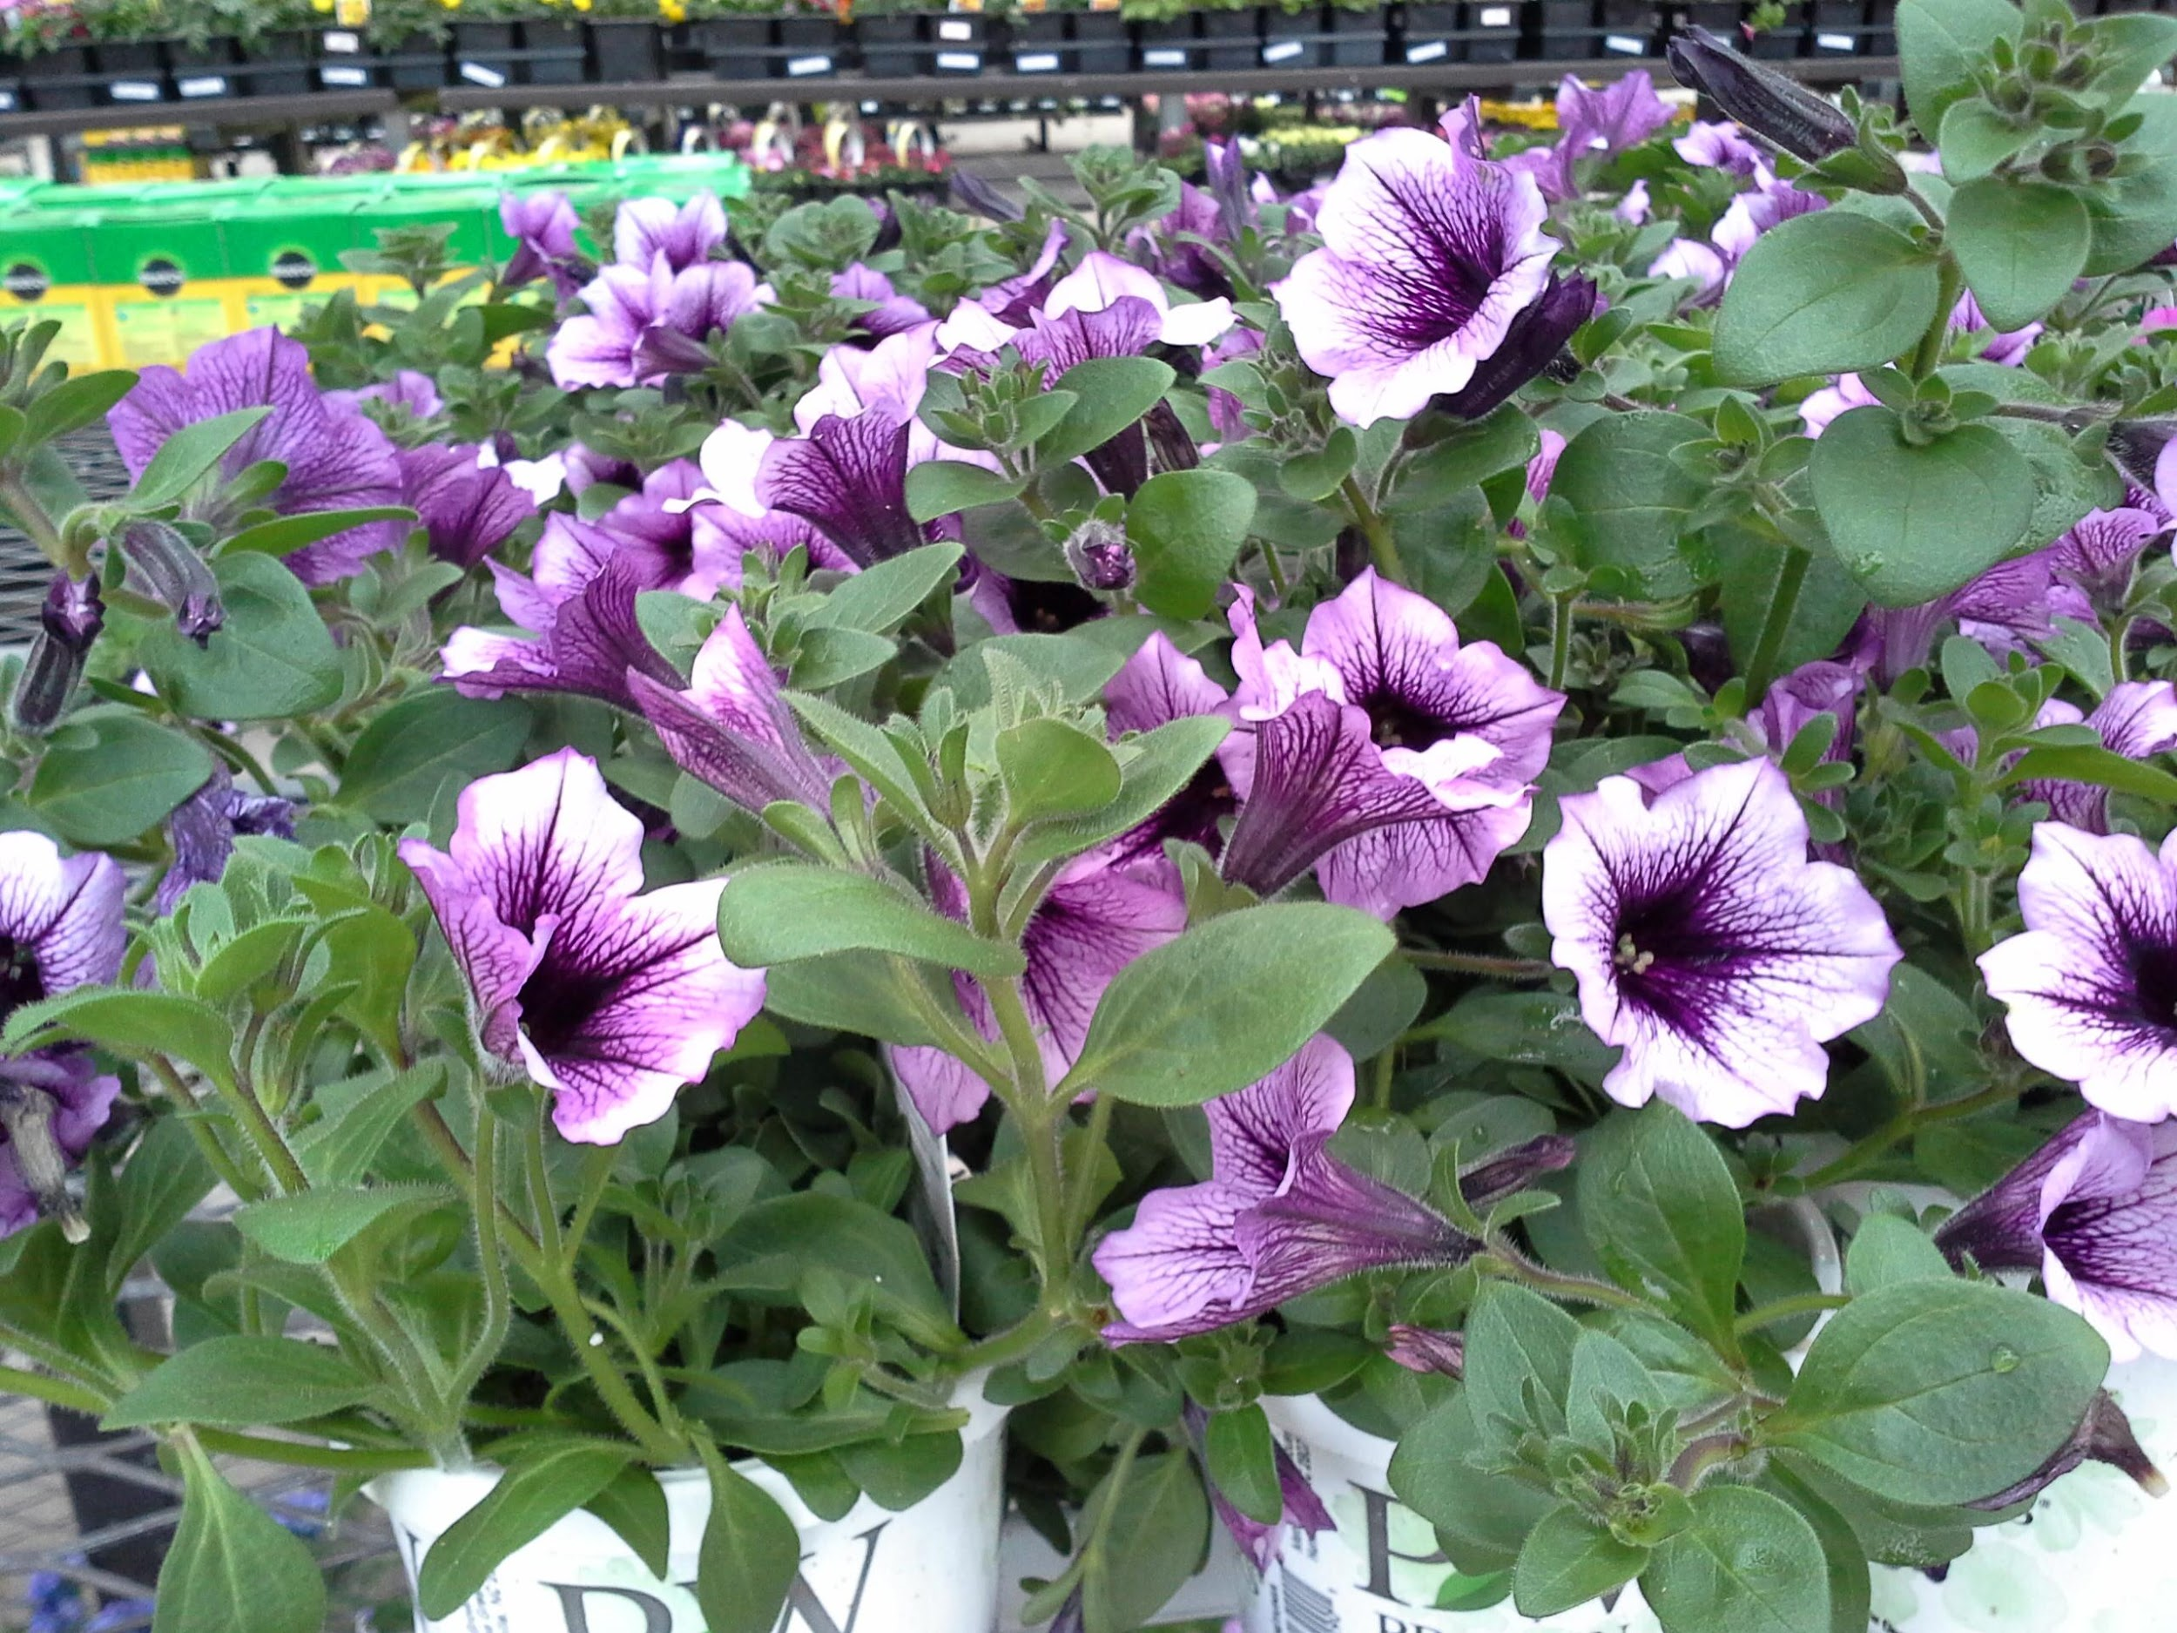
2015 Flowers Identification
State FFA Horticulture CDE

Slide 2
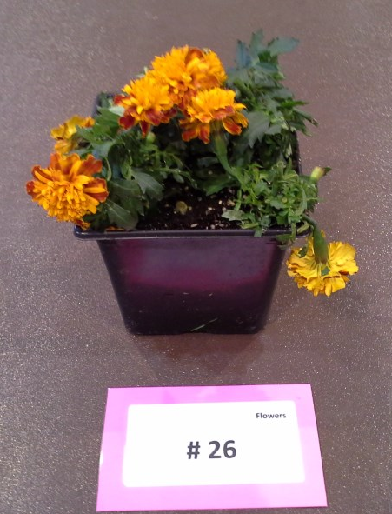
1.

Slide 3
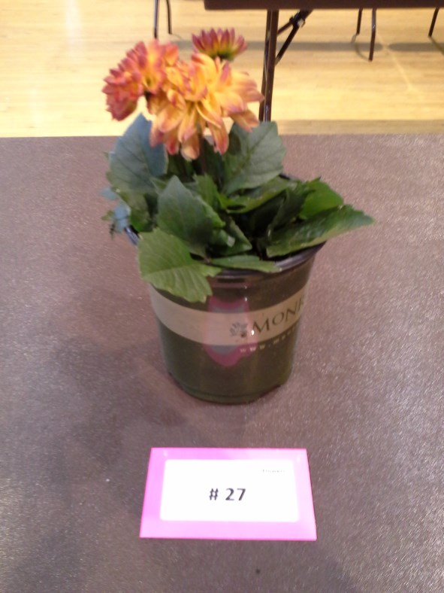
2.

Slide 4
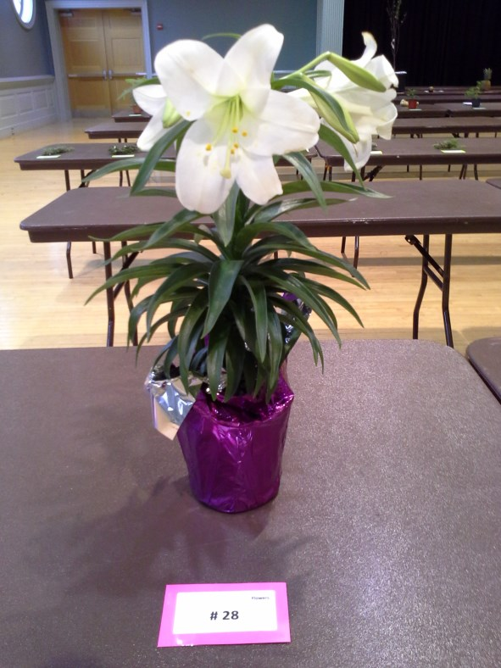
3.

Slide 5
4.

Slide 6
5.

Slide 7
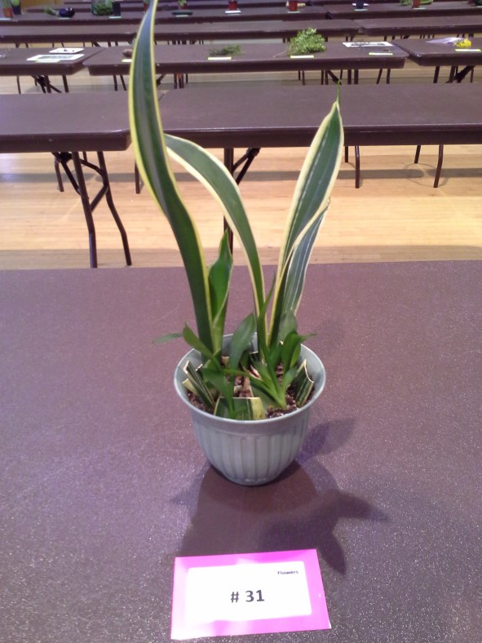
6.

Slide 8
7.

Slide 9
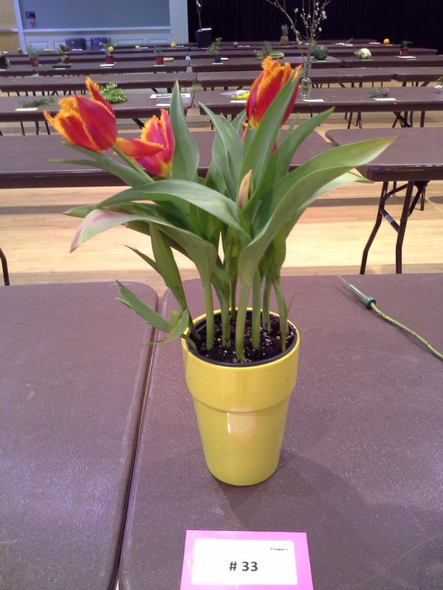
8.

Slide 10
9.

Slide 11
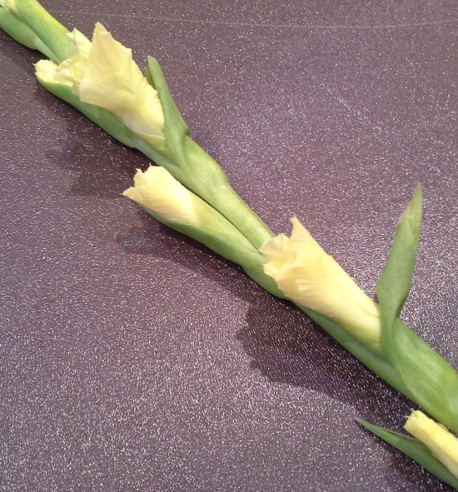
10.

Slide 12
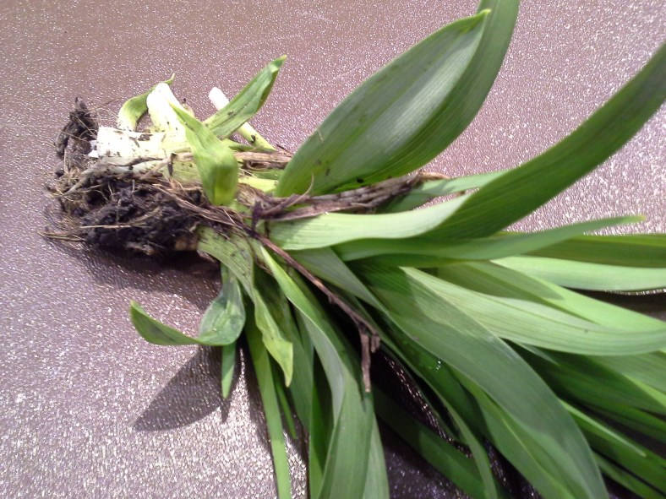
11.

Slide 13
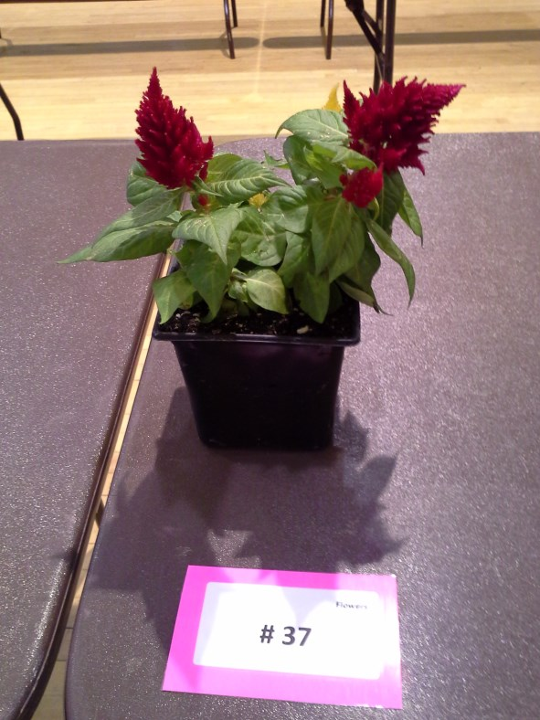
12.

Slide 14
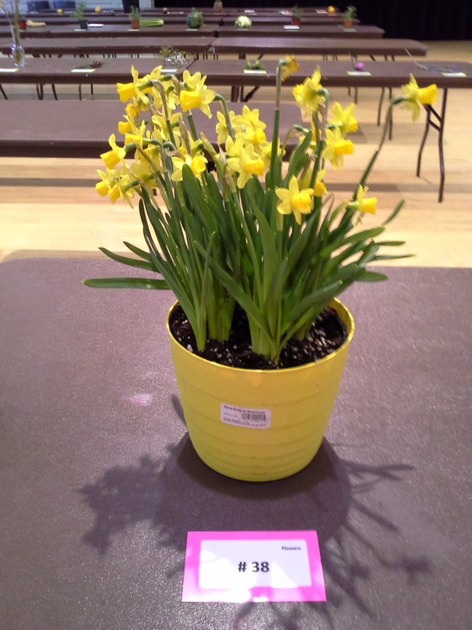
13.

Slide 15
14.

Slide 16
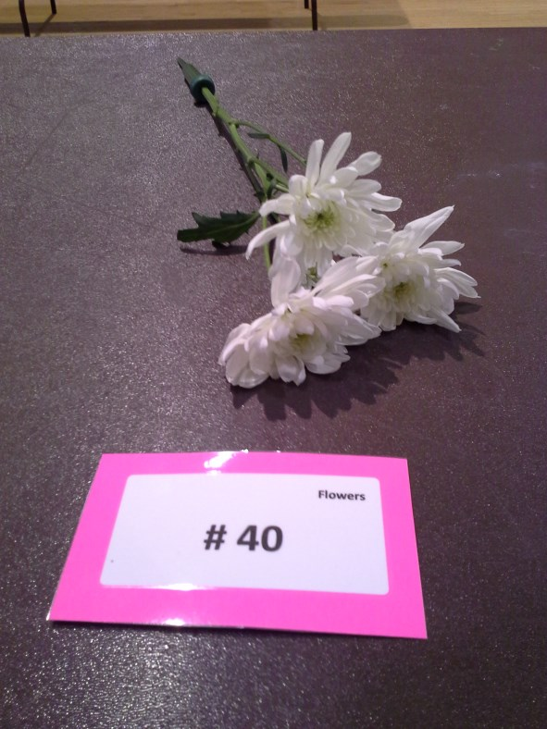
15.

Slide 17
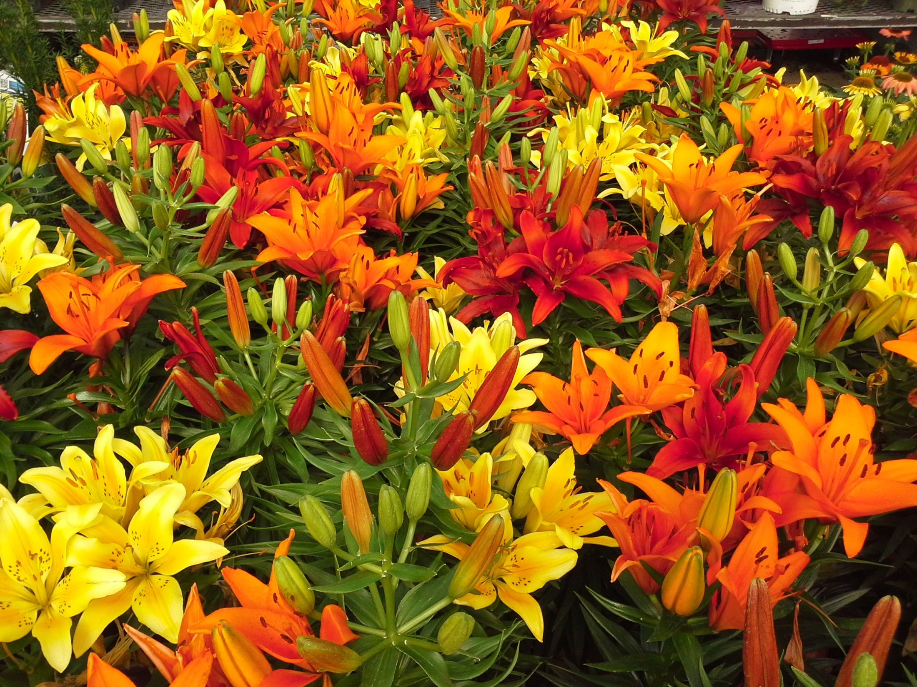
This power point was provided for you by your Superintendent:
Susan Trice
University of Maryland Extension
Horticulture Educator/ Master Gardener Coordinator
strice@umd.edu
The University of Maryland, College of Agriculture and Natural Resources programs are open to all and will not discriminate against anyone because of race, age, sex, color, sexual orientation, physical or mental disability, religion, ancestry, or national origin, marital status, genetic information, or political affiliation, or gender identity and expression.

